Slide 1

ISSS621 Data Science for Business
Project Castlery
Maximising Profit
Group 9
Lim Ming Jie Anne Chen Yiman Gladwin Lam Yu Hay Liu Zhengyao Shi Chee Liang
Notes:
INTRODUCTION
Good evening everyone. Welcom to group 9’s data science for business case presentation. Today, I'm excited to present our project and explore the way to maximising furniture company’s profits.

Slide 2
Content
INTRO
Project objective
MAIN FUNCTIONS
Recommender System
Inventory Management
Delivery Optimization
Closed-Loop System and Governance
Conclusion
Notes:
In today’s pre, will give you following portions:
INTRODUCTION
Brief introduction of Castlery and their business model
Overview of the furniture e-commerce industry and its challenges
PROJECT OBJECTIVE
Discuss the main objective of the project: maximizing profit for Castlery
Explain how this objective will be achieved through the implementation of various functions
MAIN FUNCTIONS
Discuss the three main functions that will be implemented: Recommender System, Inventory Management, and Delivery Optimization
Explain the reason of each function in maximizing profit for Castlery
Provide examples of how each function will be implemented in the company
CLOSED-LOOP SYSTEM AND GOVERNANCE
Explain the importance of a closed-loop system in e-commerce
Discuss how Castlery will implement a closed-loop system to improve governance and decision-making
Provide examples of how the closed-loop system will be integrated into the company's operations
CONCLUSION
Summarize the main points of the presentation
Emphasize how the implementation of these functions will maximize profit for Castlery
Discuss potential future developments and improvements for the company

Slide 3
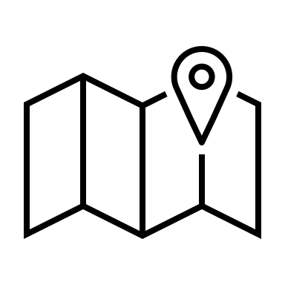
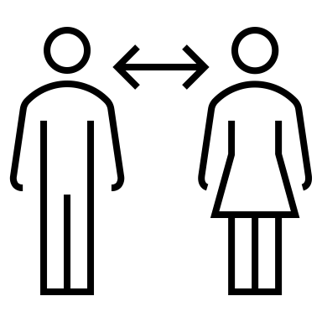
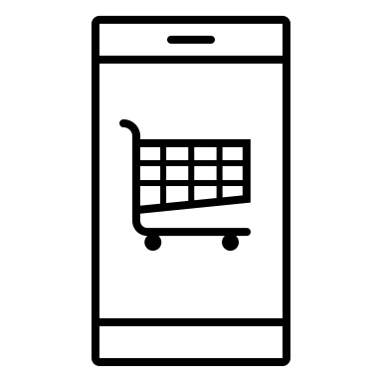
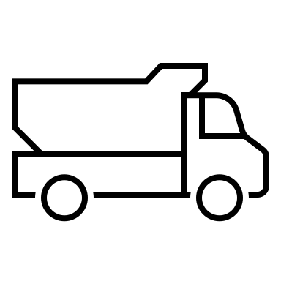
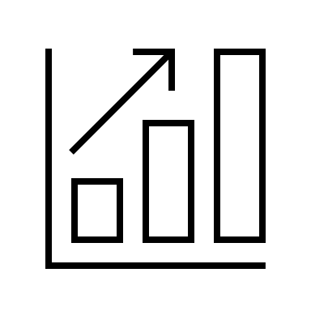

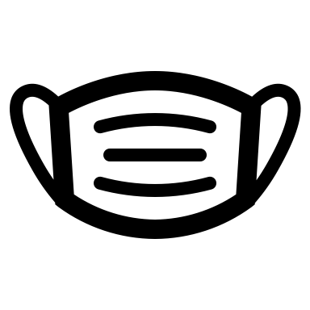
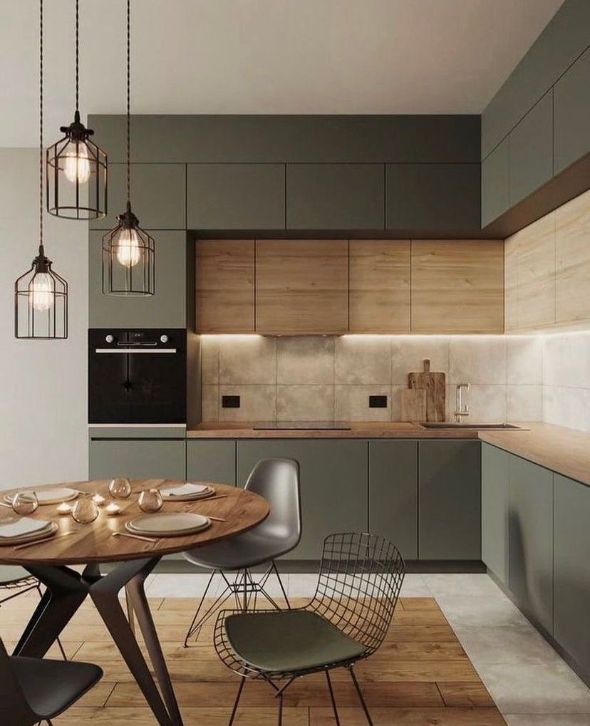
All About CASTLERY:
A home-grown furniture retailer established in 2013
Expanded to offering its products to several countries including the United States, Canada, Australia, and several European countries.
Digital- First approach
International Order
During Covid19
V
V
V
Notes:
Castlery is a home-grown furniture retailer that was established in 2013. Since then, it has expanded its operations to several countries, including the United States, Canada, Australia, and several European countries. Today, I'll be sharing with you some key features of Castlery that make it unique.
DIGITAL-FIRST APPROACH
One of the key features of Castlery is its digital-first approach. In today's world, where most consumers prefer shopping online, Castlery has made it a priority to provide an exceptional digital experience to its customers. From browsing to purchasing and delivery, everything can be done online through Castlery's user-friendly website and mobile application.
GROWTH DURING COVID-19
Another notable feature of Castlery is its impressive growth during the COVID-19 pandemic. With people spending more time at home, the demand for furniture and home decor has skyrocketed. Castlery has been able to capitalize on this trend and has seen a surge in sales and revenue during this time.
INTERNATIONAL ORDER
The third and final feature that sets Castlery apart is its ability to serve customers across borders. Castlery offers its products to several countries worldwide, making it an international brand. This has helped the company to diversify its revenue streams and increase its customer base.

Slide 4
Datasets
Raw data files:
Fact_Saleorder.csv : 5000 rows Fact_Saleorderline.csv：7898 rows
order_id | user_id | order_date | sales
100543 | 2644 | 5/26/2021 | 305.97
100559 | 4010 | 1/1/2021 | 2163
102578 | 4805 | 5/22/2021 | 29.97
saleline_id | order_id | product | category | sale_amount | quantity
563832 | 323741 | SKU 1 | Cushions | 350 | 4
559257 | 320135 | SKU 1 | Cushions | 175 | 2
562777 | 305952 | SKU 1 | Cushions | 175 | 2
La_Deliveries.csv ：1025 rows
delivery_id | total_cbm | delivery_date | cbsa_name | city | zip | population | lat | lng
28466 | 0.78648 | 25/1/2022 | Los Angeles-Long Beach-Anaheim, CA | Los Angeles | 90001 | 59832 | 33.97398 | -118.24955
32246 | 0.493039 | 8/2/2022 | Los Angeles-Long Beach-Anaheim, CA | Los Angeles | 90005 | 39732 | 34.05912 | -118.30654
28028 | 0.248724 | 21/1/2022 | Los Angeles-Long Beach-Anaheim, CA | Los Angeles | 90005 | 39732 | 34.05912 | -118.30654
Notes:
Here are our datasets used and the main variable names

Slide 5
Objective
Max Profit
=Sales- Cost
=(ASP-Cost/unit)*Quantity
Increase Sales
Reduce Cost
Inventory Management
Reduce Delivery Cost
CRM
Target Marketing
Demand Forecast
Min distance
Min man-hour
Frequent Pattern Mining
Recommender System
1. How can Castlery use more targeted marketing to improve revenue?
2. How can Castlery manage their inventory to improve revenue and reduce cost?
3. How can Castlery manage their deliveries more efficiently to reduce cost?
Notes:
Lets look at the objective
We breakdown our final goal
Max Profit
=Sales- Cost
=(ASP-Cost/unit)*Quantity
TARGETED MARKETING
One way that Castlery can improve revenue is by using targeted marketing. By analyzing the customer data, we can determine the demographics and preferences of the customers. This will allow us to tailor our marketing campaigns to specific groups of customers, resulting in more effective marketing and increased sales. By using the data set provided, we can analyze the sales data to identify which products are most popular and which customers are buying them.
INVENTORY MANAGEMENT
Another way to improve revenue is by managing inventory more effectively. By analyzing the sales data, we can identify the products that are selling well and ensure that we have enough inventory to meet the demand. This will help us to reduce the cost of inventory and improve revenue by reducing the number of products that go out of stock. We can also use the data set provided to identify the products that are selling well and ensure that we have enough inventory to meet the demand.
EFFICIENT DELIVERIES
The third way to improve revenue is by managing deliveries more efficiently. By optimizing the delivery routes and schedules, we can reduce the cost of deliveries and improve revenue. We can use the data set provided to identify the delivery locations and the delivery schedules to optimize the delivery routes. This will help us to reduce the cost of deliveries and improve revenue.

Slide 6
Objective
Max Profit
=Sales- Cost
=(ASP-Cost/unit)*Quantity
Increase Sales
Reduce Cost
Inventory Management
Reduce Delivery Cost
CRM
Recommender System
Target Marketing
Demand Forecast
Min distance
Min man-hour
Frequent Pattern Mining
1. How can Castlery use more targeted marketing to improve revenue?
2. How can Castlery manage their inventory to improve revenue and reduce cost?
3. How can Castlery manage their deliveries more efficiently to reduce cost?
Notes:
For the first task, we focused on the dimension of how to increase sales and revenue for Castlery, as a digital-first furniture e-commerce platform. We opt to achieve this goal by building a recommender system based on the past purchase orders of our customers. This will allow us to offer targeted marketing at different stages of their shopping journey, such as at the user’s cart, at the checkout page, and at the product listing.
The data science task derived from this objective is to formulate recommendation rules through frequent pattern mining.

Slide 7
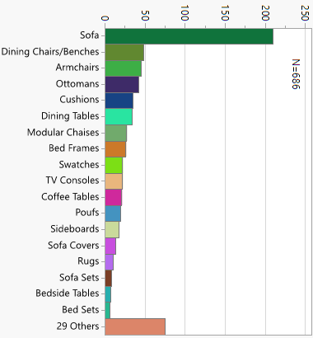
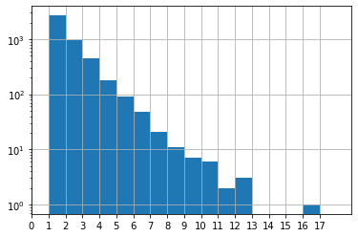
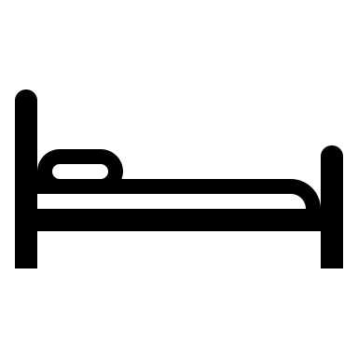





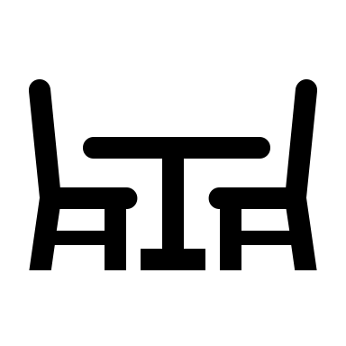
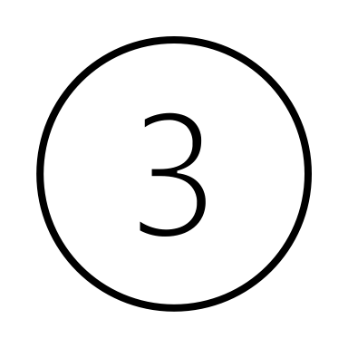
What is in the order ?
N = 7115
+
Count of items per order
Pareto of categories listed
Majority of orders have:
Possible combinations:
+
Notes:
This is a brief overview of the dataset for past purchase orders on Castlery. The first plot shows a histogram of the count of items in an order. Please note that the y-axis is plotted on a log base-10 scale. From this histogram, we can see that most of the orders have a small number of items, mostly 1, 2, or 3. The plot on the right is a Pareto chart of the categories of products listed. Based on intuition, we might already have some idea of what are some popular frequent purchase patterns, such as sofa + ottoman + cushions, or dining table + dining chair/benches.
Next, let’s try to use the Apriori algorithm to find some frequent patterns.

Slide 8
Apriori and Association Rule
Apriori Algo: Generate a k-itemset candidate by merging a pair of frequent (k-1) itemsets only if their first k-2 items are identical.​
{659 & 353} + {659 & 89} → {659 & 89 & 353} where 0.34% > min_Sup
Min_sup = 0.3%
Item | Category | Count | Support (%)
659 | Table | 30 | 0.42%
353 | Bench | 74 | 1.03%
152 | Table | 32 | 0.45%
614 | Chair | 293 | 4.10%
681 | Table | 40 | 0.56%
528 | Chair | 47 | 0.66%
89 | Chair | 140 | 1.96%
… | … | … | …
Item | Count | Support (%)
659 & 353 | 29 | 0.41%
659 & 89 | 26 | 0.36%
152 & 614 | 31 | 0.43%
681 & 528 | 37 | 0.52%
… | … | …
Item | Count | Support (%)
659 & 89 & 353 | 24 | 0.34%
… | … | …
*count = # of orders this item appears in
Notes:
We applied the Apriori algorithm to the purchase orders item sets to find frequent patterns of items that are bought together. Unlike the beer and diaper case study, which focused on categories of products, we applied the algorithm to the item or SKU level, since our objective is not to relocate a category or shelves but to recommend the customer the next exact item to buy. Here is an illustration of how the Apriori algorithm works in our dataset: we generate a 3-itemset candidate by merging a pair of frequent 2-itemsets only if they have one item in common. For example, {659, 89, 353} comes from merging {659, 353} and {659, 89} frequent itemsets, while they fulfill the minimum support threshold of 0.3%.

Slide 9
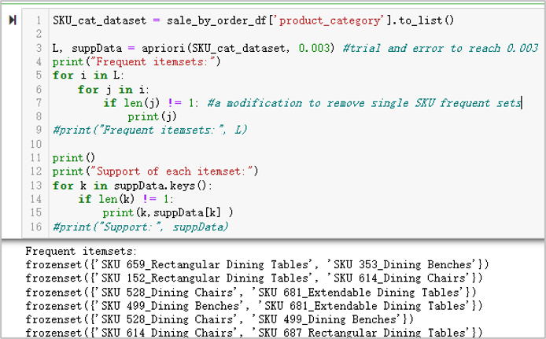
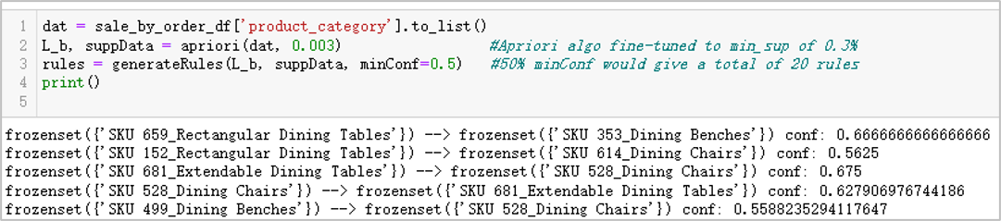
Apriori and Association Rule
Apriori Algo: Generate a k-itemset candidate by merging a pair of frequent (k-1) itemsets only if their first k-2 items are identical.​
{659 & 353} + {659 & 89} → {659 & 89 & 353} where 0.34% > min_Sup
Min_sup = 0.3%
Item | Category | Count | Support (%)
659 | Table | 30 | 0.42%
353 | Bench | 74 | 1.03%
152 | Table | 32 | 0.45%
614 | Chair | 293 | 4.10%
681 | Table | 40 | 0.56%
528 | Chair | 47 | 0.66%
89 | Chair | 140 | 1.96%
… | … | … | …
Item | Count | Support (%)
659 & 353 | 29 | 0.41%
659 & 89 | 26 | 0.36%
152 & 614 | 31 | 0.43%
681 & 528 | 37 | 0.52%
… | … | …
Item | Count | Support (%)
659 & 89 & 353 | 24 | 0.34%
… | … | …
*count = # of orders this item appears in
: Looking for frequent itemsets
Generate recommender rules from frequent itemsets​ :
Notes:
Below are some of the code snippets with results printed. A slight modification to the frequent pattern mining code is not to show frequent itemsets with single items, since there are numerous of them, but less insightful for recommendation rules. Furthermore, recommendation rules are generated from the Apriori algorithm.

Slide 10
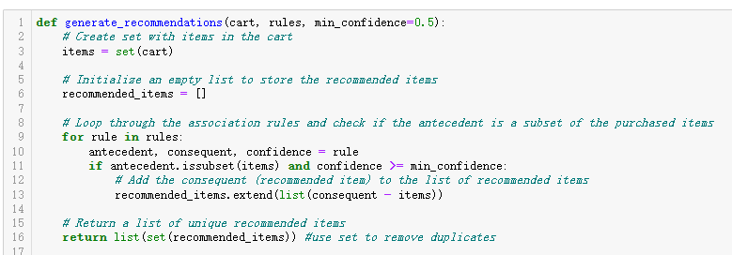
Recommender System
There are way more orders buying chair/bench SKUs than table SKUs
Implying customers buying table would more likely pair with chairs
Whereas customers might just buy chair/bench without pairing a table?
Item | Category | Count* | Support (%)
659 | Table | 30 | 0.42%
353 | Bench | 74 | 1.03%
152 | Table | 32 | 0.45%
614 | Chair | 293 | 4.10%
681 | Table | 40 | 0.56%
528 | Chair | 47 | 0.66%
89 | Chair | 140 | 1.96%
… | … | … | …
*count = # of orders this item appears in
Let’s see how the recommender rules tell us.
Notes:
From the count and support table of our popular items, we observed that there are way more orders buying dining chair/bench SKUs than dining table SKUs. However, we also noticed that they often appear together in the 2-item and 3-item frequent itemsets. Does this imply that customers will definitely pair a table with chairs, but might just buy a dining chair without pairing it with a table? We will try to find more insight via a recommendation generation function that takes in the item in the user’scart and the recommendation rules we have.

Slide 11
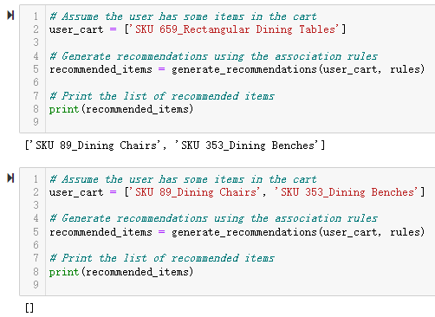
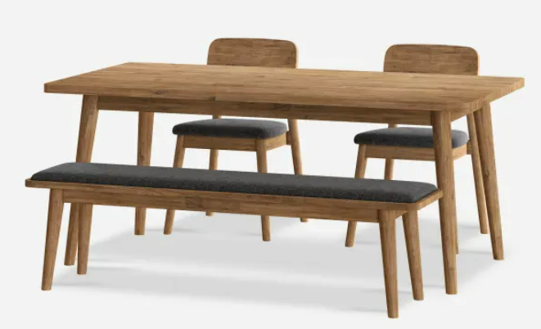
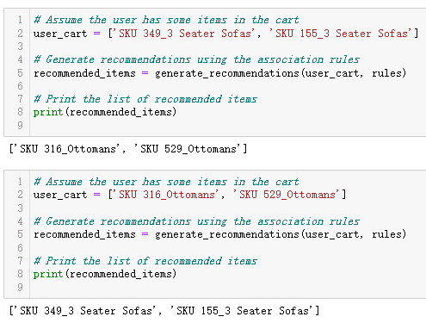
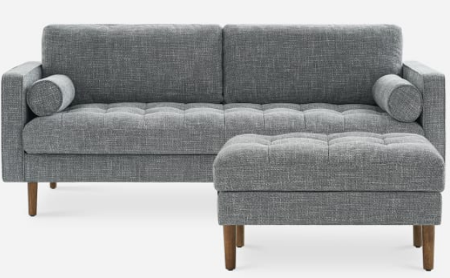
Recommender System
Item | Category | Count* | Support (%)
659 | Table | 30 | 0.42%
353 | Bench | 74 | 1.03%
152 | Table | 32 | 0.45%
614 | Chair | 293 | 4.10%
681 | Table | 40 | 0.56%
528 | Chair | 47 | 0.66%
89 | Chair | 140 | 1.96%
… | … | … | …
For the Dining table and Chairs and Benches:
*count = # of orders this item appears in
For the Sofa and Ottoman pairs:
Q: Customers buying table would more likely pair with chairs, but not vice versa?
A: The recommender rules suggests
Customers would buy this dining table SKU and pair with chairs and benches. But not vice versa.
Notes:
By experimenting with the recommender function, we saw that it suggests customers who buy this dining table SKU to pair it with chairs and benches that fit the design. However, it does not confidently recommend the dining table if we only put the respective chair and bench in the cart. This might happen if the customer just wants to buy additional chairs for some special occasions like parties or reunion dinners.
On the other hand, for sofa and ottoman, the recommender always recommends to pair them up both ways: sofa to ottoman, ottoman to sofa. This implies that customer purchase patterns are very likely to buy them together as a set since they fit the full functional needs as the centerpiece of the living room.
To wrap up, this solution covers recommendation based on the past orders made on the site. There are further enhancements we can do like more customized recommendation from user’s purchase history or recommendation based on inventory level or seasonal/promotional campaigns.

Slide 12
Objective
Max Profit
=Sales- Cost
=(ASP-Cost/unit)*Quantity
Increase Sales
Reduce Cost
Inventory Management
Reduce Delivery Cost
CRM
Recommender System
Target Marketing
Demand Forecast
Min distance
Min man-hour
Frequent Pattern Mining
1. How can Castlery use more targeted marketing to improve revenue?
2. How can Castlery manage their inventory to improve revenue and reduce cost?
3. How can Castlery manage their deliveries more efficiently to reduce cost?
Notes:
For the next few slides, I will bring you through on how we tackled inventory management and forecasting for Castlery.
The business problem was how Castlery can manage their inventory to improve revenue and reduce costs. Lets find out

Slide 13
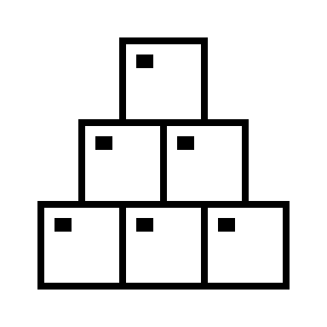
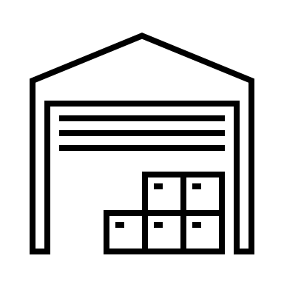
Inventory Management & Forecasting
Translate Business Problem into goals
Business Problem:
How can Castlery manage their inventory to improve revenue and reduce cost?
Expensive： furniture pieces take up
large amount of warehouse space
Sell slowly compared
with other types of products like food
Goal 1 :Lower inventory to minimise holding costs
TOO MUCH INVENTORY
TOO LITTLE
INVENTORY
Cause a loss of sales
Lead to additional costs in
trying to speed up production processes or
delivery lead times.
Goal 2 :Maintain sufficient inventory levels to avoid stockouts
(i.e., lost sales)
Notes:
The first thing to do is to break down this business problem into smaller data science problems. This is an important step because business problems do not always require a data science approach. For example, there could be other possible business solutions, like making disassembled furniture (like IKEA) or not holding any stock at all by delivering from production.
In this case we translated it into two sub goals. (1) Lowering inventory to minimise holding costs (2) maintaining sufficient inventory levels to prevent stock outs. It could be expensive if we carry too much inventory and on the other hand, we run a risk of stock out if we carry too little. An impromptu solution is perhaps to find out the balance of these two goals. Let’s dive in.

Slide 14
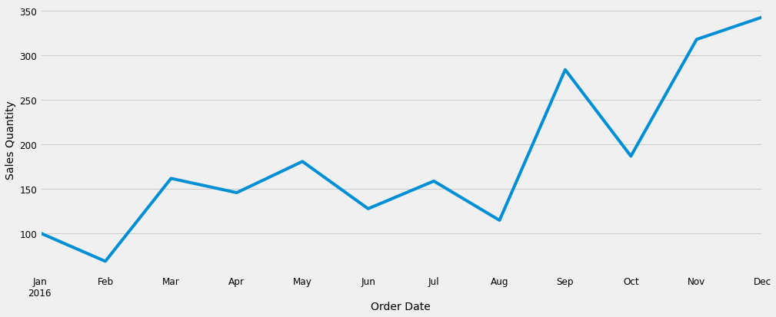
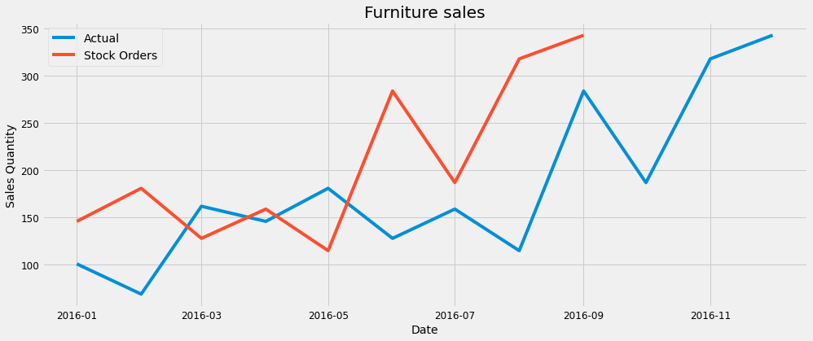
Inventory Management & Forecasting
How much to order? And when to order?
1
2
3 months lead time
Naïve solution: order as we sell
Problem: stocks take time to deliver
Solution 1: order in advance Problem : How much to order?
Notes:
(figure 1) The naïve solution is probably to order as we sell. However Castlery’s furniture has a lead time of 3 months, meaning it takes 3 months to reach the warehouse after an order to restock is placed. (figure 2) so we actually need to order stocks in advance of demand? But how much?

Slide 15
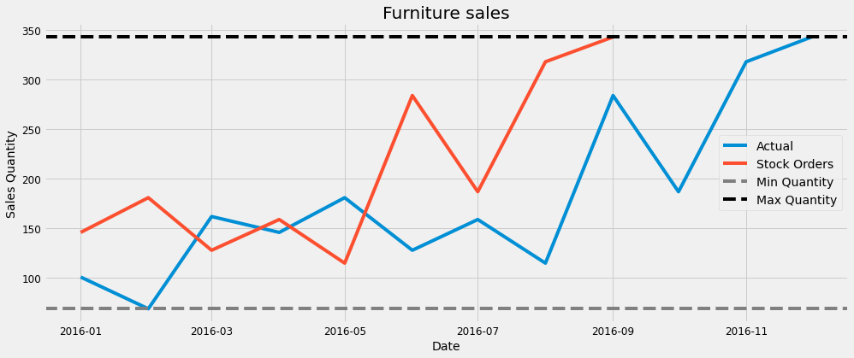
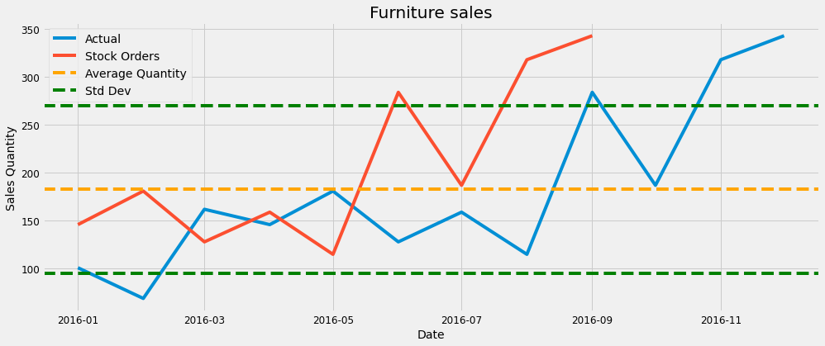
Inventory Management & Forecasting
How to handle variance
3
4
Overstock
High sales
3 months lead time
Take Std Dev
Risk Stockouts
Low sales
Solution 2: Order at Max / Min demand? Problem: Costs from overstocking, stockout
Solution 4: identify a representative line of demand
Notes:
To solve that, essentially, we would need be trying to figure out what is a representative line of demand. (figure 3). Ordering at min and max demand is clearly not suitable as it would mean overstocking or understocking. That leaves us with the average. Is it suitable? Let’s take a deeper look.

Slide 16
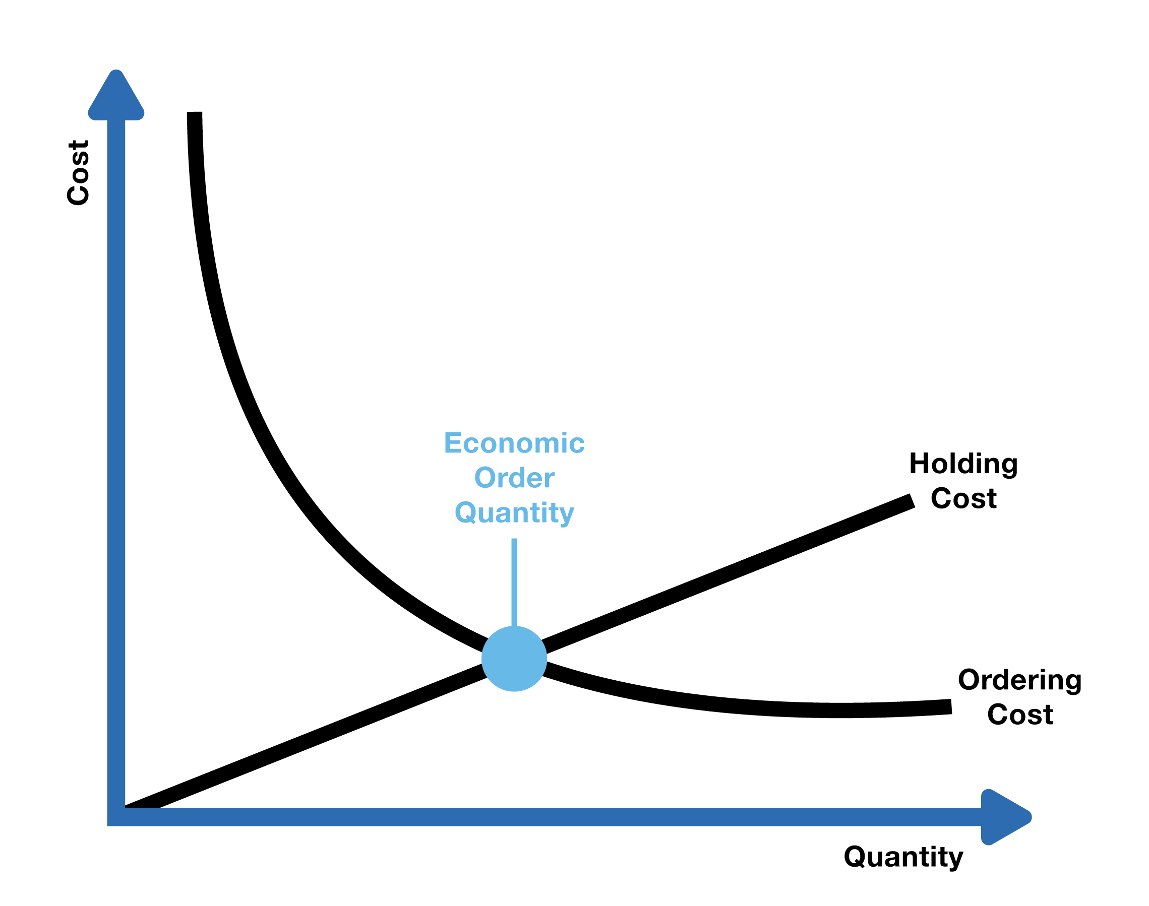
Inventory Management & Forecasting
Introduction to ROP, SS and EOQ concepts
4
Solution 4: Average the demand and take SD
How do we quantify it?
Identify the reorder point, safety stock and economic order quantity
Reorder Point (ROP): ROP is the inventory level at which a new order should be placed to avoid stockouts
ROP = (Demand x lead time) + Safety Stock
Safety Stock (SS): SS is the extra inventory held to mitigate the risk of stockouts due to demand variability.
SS = Z x σ x lead Time (Z is Z-core, σ is SD)
Economic Order Quantity (EOQ): EOQ is the optimal order quantity that minimizes the total cost of inventory management
EOQ = Sqrt((2 x demand x Ordering costs) /Holding Costs)
High sales
3 months lead time
Take Std Dev
Low sales
Solution is shaping up, but we still have some
problems:
Does not take trends into account
Does not work for high variability in demand
EOQ = Sqrt(2DS/H)
Notes:
If we take the demand across a period of one year as an average, we can introduce 3 concepts to figure out when to order and how much to order.
Because demand is not fixed, it is not practical to order based on time. instead, reorders should be based on the amount of current stock that is expected to last till new stocks arrive. This is called the Reorder point (ROP). The formula is given by demand x lead time + safety stock. The idea is that stocks take time to arrive, so we should ensure that we still have sufficient stock to last us till then. This is reflected in demand x lead time.
Then what is safety stock? We saw from earlier naïve solutions that because demand varies, taking an average would not ensure that peak demand is met. Over here we can apply the statistical concept of variance to capture these fluctuations of demand. The formula is given by SS = Z x σ x lead Time where Z is Z-core, σ is SD. Castlery can then decide what service level they want to meet by adjusting the Z score. A Z score of 1.96 for 95% confidence would mean that variations in demand can be met 95% of the time.
Ok, now that we had figured out when to order, how much do we then order? Keep in mind that we need to minimise the holding cost of inventory. We can derive this with the EOQ formula. EOQ is basically the intersection of holding costs and order costs where the derivative is 0. We can see visually in the small graph at the bottom right corner that holding costs increases as we order more while ordering costs drops. They both intersect at a point which should represent the ideal cost to quantity ratio.
Now we can ask ourselves again if this is a suitable solution. If demand is more or less constant with no trends, this could be a suitable solution, however we can see that the demand actually has an increasing trend and high variability. What would be a better idea then?

Slide 17
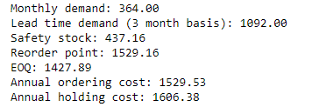
Inventory Management & Forecasting
Is there a better way to project demand?
5
Take Std Dev
Solution 5: Derive linear regression of Annual demand
Notes:
Let’s go back to what I mentioned earlier about finding a representative line for demand. While we can apply averages to almost everything, it is not always the most representative, just like what we learnt in lesson 2 on representing customer purchases. In Castlery’s case, we can apply linear regression to try and draw a representative line for the sales and use it to forecast demand, before swapping it into the earlier ROP, SS and EOQ equations to derive more accurate figures
Can we still do better?

Slide 18
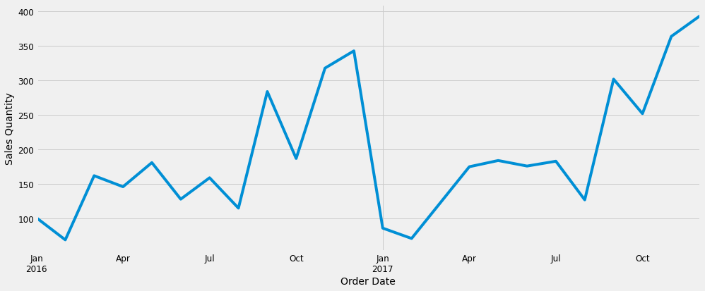
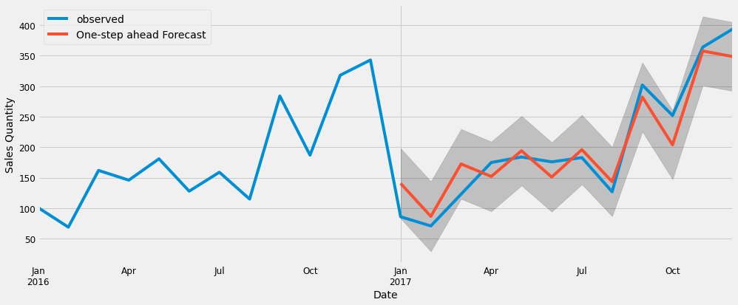
Inventory Management & Forecasting
What if the demand looks like this?
Data used for linear regression
Actual demand
 | Monthly demand | Lead time demand | Safety stock | ROP | EOQ | Annual ordering cost | Annual holding cost
ARIMA | 260.84 | 939.63 | 252.39 | 1192.02 | 1260.70 | 884.61 | 663.45
EOQ | 364.00 | 1092.00 | 437.16 | 1529.16 | 1427.89 | 3134.96 | 783.74
ARIMA forecast
(trained on 2016 data)
vs
Actual demand
Final solution:
Apply a more appropriate forecasting technique like AutoRegression Integrated Moving Average (ARIMA) and compute EOQ, ROP and SS on a seasonally basis rather than yearly
Notes:
What if the actual demand looks like this?
In top figure, we have sales figure for 2016 and 2017. the plot in the boxed part is what we’ve been seeing so far. We can see that if we simply do a linear regression over all the values of a data set, it may not always do very well in forecasting values, especially if there are large variations or seasonal trends.
We can try to apply better forecasting models like the Autoregression Integrated Moving Average or ARIMA. While a Linear regression simply tries to formulate a relationship between two sets of variables. The ARIMA model attempts to derive new data points based on prior values while identifying trends, seasonality, and cyclic patterns.
The ARIMA modelling for demand would give us a lower ROP and EOQ values which matches with a drop in demand at the beginning of the year.
It is important to note 2 things here. (1) forecasting methods usually derive their values based on past performance. Hence it is important to continuously update the model with fresh data as they come in and, (2) while data science approaches can provide us valuable inputs and solutions based on the data, the applicability of the solution would still need to be considered within the business context and needs.

Slide 19
Objective
Max Profit
=Sales- Cost
=(ASP-Cost/unit)*Quantity
Increase Sales
Reduce Cost
Inventory Management
Reduce Delivery Cost
CRM
Recommender System
Target Marketing
Demand Forecast
Min distance
Min man-hour
Frequent Pattern Mining
1. How can Castlery use more targeted marketing to improve revenue?
2. How can Castlery manage their inventory to improve revenue and reduce cost?
3. How can Castlery manage their deliveries more efficiently to reduce cost?
Notes:
Another way to maximise profit is to reduce delivery cost as it is one of the main cost drivers for Castlery.
Specially, we want to see how Castlery can manage their deliveries more efficiently to reduce cost.

Slide 20
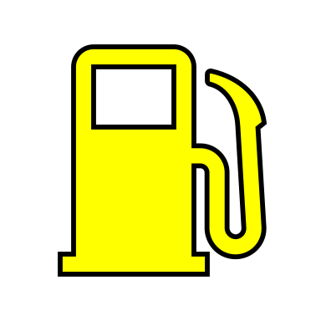
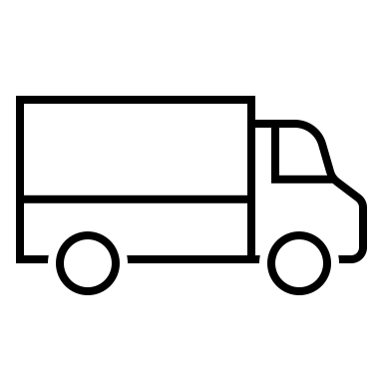
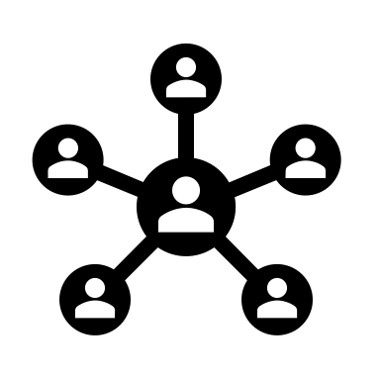
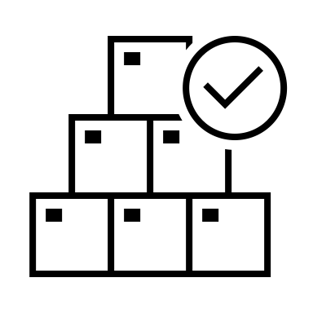

The Last Mile Delivery Problem
1.The fuel cost
2.The man hours
Assumptions:
We assume that by reducing total distance travelled, it reduces the total number of hours needed to pay the drivers and reduces the fuel cost from travelling less which translates to cost savings
How can we reduce the total distance travelled?
Notes:
For Castlery’s delivery fleet, there are 2 main cost drivers. Mainly the fuel cost incurred by delivery vans and the hourly wages of delivery workers.
In our analysis, we assume that by reducing the total distance travelled, it reduces the total number of hours needed to pay the workers and also the fuel cost from travelling less, which leads to cost savings.
As such, we will focus our solution in reducing the total distance travelled.

Slide 21
Current Delivery Situation
How does delivery look like on a busy day, an average day and an easy day?
Average Day : 2022-01-27
Busiest Day : 2022-01-27
Easy Day : 2022-01-13
*Random routing distances were summed using code selecting random choice of coordinates
Notes:
In our dataset, we have delivery information of 13 delivery days. On a busy day Castlery has 40 deliveries to make per day. On the least business day, they only have 9 orders to make. On a typical day, they have about 30 deliveries to make.
If Castlery were to randomly sequence their delivery orders, on their busiest day they would travel around 2103km in total, on their typical day they would travel around 1247km in total and on their least busy day they would travel around 483km.

Slide 22
How does non-optimized routing translate to the number of man hours and diesel costs incurred?
Diesel cost: 0.45 USD/km
Notes:
If we are to translate the distance travelled in terms of cost, this would mean Castlery would incur 8hrs to 35hrs of salary cost depending on how busy the day is AND $217 to $947 of diesel fuel cost.

Slide 23
Problem Modelling and Assumptions
1.Drivers start and end at the warehouse
3.Each customer is served only by 1 van
4.Each furniture is delivered entirely
2.Each van is identical
A Greedy Approach | Heuristic Search Method
At each delivery decision point, choose the next location that is closest to current distance. | Search for a route order that ensures cargo space is within each van’s cargo limit while reducing total distance travelled by all vans
Sum of all minimum distance travelled will lead to a minimum total distance
5.Castlery has an existing fleet of delivery vans and can increase, decrease number of vans used without additional cost
Notes:
To start solving the problem, first we need to model the problem and make some assumptions.
Firstly, the driver will start and end at the warehouse
Each van is identical in terms of fuel consumption.
Each customer is served by only 1 van.
Each furniture is delivered entirely. There will not be a case where half the furniture is delivered by van 1 and by van 2.
We assume that Castlery has an existing fleet of delivery vans and they can freely increase or decrease the number of vans with no additional cost.
We can use a greedy approach to solve the problem. At each delivery decision point, choose the next location that is closest to the current location. Hopefully by doing so, the sum of all minimum distances locally will lead to a global minimum total distance.
In each decision point, we can make use of heuristic search to look for the next delivery location, that at the same time does not exceed the van’s current capacity!

Slide 24
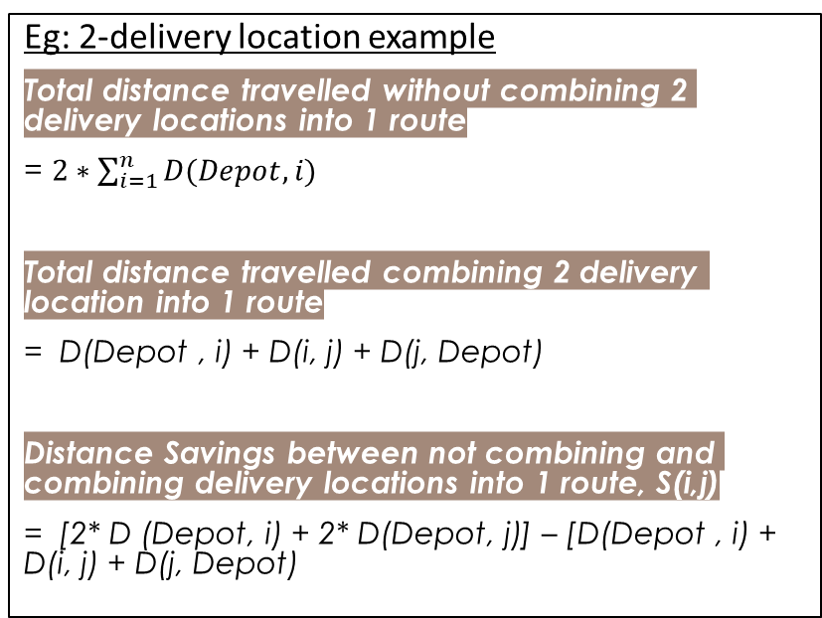
Solution: Capacitated Vehicle Routing Problem
Clarke & Wright Savings Algorithm:
Identifies a sequence of route for drivers to follow such that it minimizes the total distance travelled, all customers are served, and the delivery items does not exceed each van’s capacity
Calculates the distance savings if we are to combine delivery locations into 1 delivery route and plans optimal route
Step | Category
1 | Calculate savings for each pair of distances S(i,j) when combined. Rank them in descending order
2 | Starting from highest savings Add sequence i-> j into delivery route
3 | Ensure neither i or j are already in the route otherwise skip to the pair with next best savings
 | If existing route ends with j, the next pair of sequence added will start with j
 | If vehicle capacity constraint is not exceeded
4 | Process step 2 to 3 until S(i,j) list is exhausted and stop
Eg: 2-delivery location example
Total distance travelled without combining 2 delivery locations into 1 route
= $2∗\sum_{i=1}^{n}{D(Depot, i)}$
Total distance travelled combining 2 delivery location into 1 route
= D(Depot , i) + D(i, j) + D(j, Depot)
Distance Savings between not combining and combining delivery locations into 1 route, S(i,j)
= [2* D (Depot, i) + 2* D(Depot, j)] – [D(Depot , i) + D(i, j) + D(j, Depot)
Notes:
We looked into existing literature and realize we can model the problem as a capacitated vehicle routing problem. To solve this problem, we can use the Clarke and Wright Savings Algorithm.
This algorithm identifies a sequence of route for the delivery driver to follow such that it minimizes the total distance travelled. The algorithm also ensures all customers are served and the delivery items do not exceed the van’s capacity.
The algorithm works by considering the distance savings metric if we are to combine delivery locations into 1 route.
For example, a 2-delivery location job.
The base problem can be modelled as a van starting from the warehouse and travelling to the delivery location and back to the warehouse to pick up the next furniture. It then make the next delivery, and travel back. Total distance will be summation of distance travelled from depot to point i , for the set of location I, multiplied by 2.
This is in comparison to putting the 2 deliveries into 1 delivery route which is travelling from depot to point I, then point I to point j, and finally point j back to depot.
The distance savings metric is therefore the distanced saved by combining these deliveries into 1 route compared to when not doing so.
The first step of the algorithm is to compute the distance savings for each delivery location pairwise and then rank them in descending order.
The next step is to sequence the location pairs with the highest distance savings first.
At each following iteration, the algorithm will ensure the next pair of location chosen has not already appeared previously. It also ensures that if the previous route ends with point j, the next pair selected will start from point j. And more importantly it also ensures vehicle capacity will not be exceeded.
The algorithm will keep iterating until the end of the distance savings list.

Slide 25
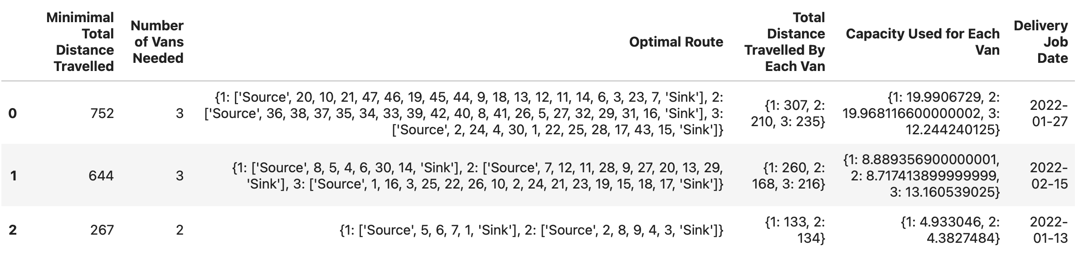
Route Optimisation Results
Used VRPy library
Distance is computed using GoogleMaps API to more accurately compute the driving distance between the delivery locations
For 27/1/22 orders: | For 27/1/22 orders:
Total distanced travelled by vans | 752km
Number of vans needed | 3
Van capacity | Van 1 capacity: 19.99 cbm used
 | Van 2 capacity: 19.97 cbm used
 | Van 3 capacity: 12.24 cbm used
Van 1 will start from depot to order 20 then to 10 to 21 …… to 7 then back to depot | Van 1 will start from depot to order 20 then to 10 to 21 …… to 7 then back to depot
Notes:
In our code, we used the VRPy library. The distance metric was calculated using Google Maps API to more accurately compute the driving distance between locations.
Based on our model used, Castlery will be able to identify how many vans they need to mobilise for that delivery date and what sequence of delivery should their drivers follow.
For example for deliver date 27 Jan, total distance travelled by all vans is 752km. The capacity used by each van is 12.24 to 19.99 cubic meter and 3 vans are needed.

Slide 26
Results – Random vs Optimised Routing
Distance Travelled (Random versus Optimised)
Based on estimated 60km/hr
Diesel cost:
0.45 USD/km
Notes:
Thank you. I will be covering the comparison of the random routing versus optimized routing results.
The bars in grey on the charts are related to the random routing variables. For example, the busiest day random routing distance of 2103km has reduced more than 50% to 785km as shown by the blue bar, after the optimized routing. Similarly, the average day and least busy day random routing distances are compared with the yellow and green bars of optimized routing respectively, showing a significant decrease in distances travelled.
We are also interested to see the effects on the number of man hours due to the reduction of distance travelled. For the busiest day, a day’s job of 35 man hours has decreased to 13 hours.
Similarly, for the Diesel cost, on the busiest day, the diesel cost of 946 USD has reduced significantly to 353 USD.

Slide 27
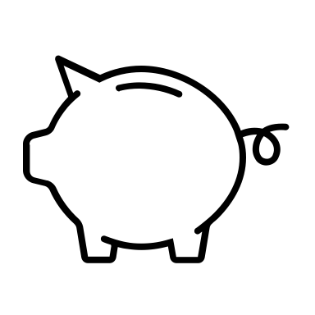

Business Savings – Optimised vs Non-Optimised Routing
Cost Savings totals to
$4004 USD or ~57%
of total cost!
Factors | Optimised Routing | Non-optimised Routing
Total Distance Travelled (Km) | 1649 | 3833
Manpower cost (23 USD/hr) | 632.12 | 1469.32
Diesel cost (0.45 USD/km) | 742.03 | 1724.81
Total Cost (USD) | 3023.15 | 7027.13
Final Savings (USD) Total Cost (non-optimised) - Total Cost (optimised) | 4003.98
Notes:
We are therefore interested to see how much cost savings are gained when optimized routing is used for the deliveries.
After some investigation on the average delivery man hour cost, diesel costs in the US, we tabulated the cost savings results in this table, and arrive at a cost savings of up to 4004 USD or approximately 57% of the total cost!

Slide 28
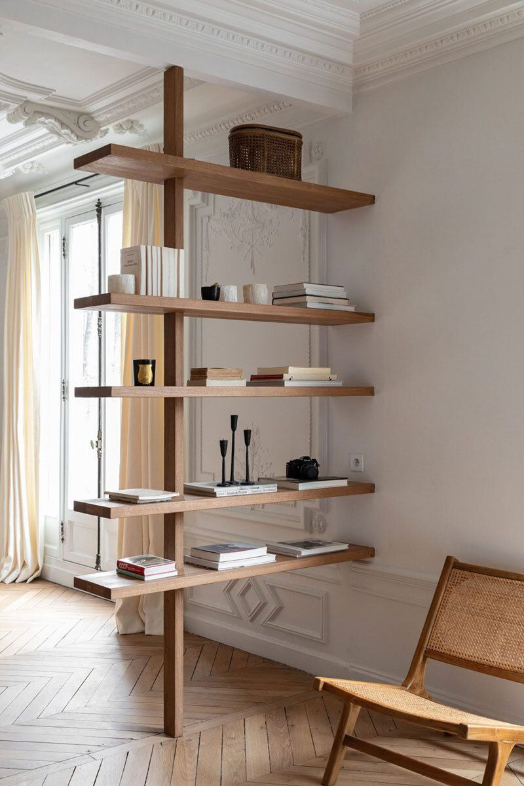




Last Mile Data Feedback Loop
Collect data for different traffic conditions and for average
speeds of different routes
Collect data for maximum and minimum number of vans needed
Collect data on van maintenance costs which facilities better vehicle fleet maintenance and planning
Understanding the sales history, delivery history and odd shaped cargo to formulate the best method to fit in various furniture pieces that maximises the space.
Collect data on total delivery time for each driver - add in constraint to limit working hours
Notes:
The closed-loop data ecosystem can be built around the digital facets of sales & marketing, demand analysis & inventory management, delivery optimization, and finally customer feedback. By ensuring the data flow is constant through the processes, with consistent, regular monitoring, and with the attitude for continuous improvement, customer satisfaction and business profit can be enhanced continuously.

Slide 29


Last Mile Data
Feedback Loop
Collect data for different traffic conditions and for actual average speeds of different routes
Fleet Management - Collect data for maximum and minimum number of vans needed
Collect data on total delivery time for each driver - add in constraint to limit working hours
Collect data on van maintenance costs which facilitates better vehicle fleet maintenance and planning
Understanding the sales & delivery history and odd shaped cargo - to formulate the best method to fit in various furniture pieces that maximises the space
Notes:
So, how can we use a feedback loop for the optimized delivery process?
We have selected 5 aspects where the organization can collect data and use it for further analysis or improvement.
For example, different traffic conditions and actual average speeds of different routes can be collected. The shortest route on google map may not necessarily be the fastest route!
2ndly, to have a better fleet management, data should be collected for the maximum and minimum number of vans needed over a longer period of time. Not everyday is a busy delivery day requiring 5 vans for example, and not everyday is an easy delivery day that only requires 1 van. If enough data is collected, the organisation may be able to establish just enough number of vans for a typical day.
In a similar context, van maintenance costs can be collected to better facilitate vehicle fleet maintenance and planning as part of the optimisation process.
4thly, data on total delivery time that each driver is putting in should be collected. If necessary, driving hours can be limited to enable better manpower arrangement and better welfare for the drivers.
Finally, looping in the sales, delivery history and understanding odd shaped cargo can help the organisation formulate the best method to fit in various furniture pieces such that space in the truck is maximised, and lesser trips are required. For example, in the earlier example provided by Zhengyao, the sofa is the most popular item. If the organisation can find an optimal way to pack the most popular pieces together, space in the truck can be better utilised, and more pieces can be delivered in a shift’s work.

Slide 30
Closed-Loop Data
Eco-system
Sales History, Recommender System &
Targeted Marketing
Intelligent Inventory Management & Forecasting
Customer Feedback & After-sale Service
Delivery Optimisation, Routing Efficiency & On-Time Delivery
Notes:
We come to make overall sense of the entire closed-loop data ecosystem. The organization should look at how the data from each process can be inputs for the next process so that there is a continuous transfer of valuable information throughout the process.
The closed-loop data ecosystem can be built around the digital facets of customer and operational data from sales & marketing, intelligent inventory management & forecasting, delivery optimization. In addition, there should be customer feedback, which is essential information for the organization to know how they are doing and what can be done better. A data management system should then be employed to integrate and manage data from the various sources. This will help ensure that the data is accurate, consistent, and up-to-date.
Once data is collected from the various sources, analyses should be done to extract valuable insights to make informed decisions and take action. With the attitude for continuous improvement, the organization will need to monitor and evaluate the impact of the actions on the business outcomes and refine their approach accordingly. Only then, customer satisfaction, innovation and business profit can then be enhanced continuously.

Slide 31
Data Governance
Privacy, Ownership and Data Security Concerns
Recommender systems rely largely on user data like purchase history. Customers may feel that they have a right to ownership and control over their own data
Some customers may not even be aware that their data is being analysed, which can lead to trust issues with the organization later on.
Risk that customer data could be misused, sold, or leaked, leading to privacy violations.
Possible Strategies
Transparency and consumer trust are essential in successful business practices
For transparency: request customer consent to use their data and/or offering incentives to the customer
Have a data management system that guards against data leakage, misuse. Secure user storage, clear data policies, anonymization of user data, staff training and awareness are some possible strategies
Notes:
Finally, the organization needs to consider the data governance of the data ecosystem. Here, we bring up the issue of the privacy, ownership and data security concerns.
In our discussion, the recommender system rely on the customer’s purchase history in order to recommend certain products that the customer may also be potentially interested in. A recommender system may also analyse a customer’s profile such as their age, spending behaviour, so that the different groups of customers can be marketed to differently with more customisation. Customers may feel that they have a right to ownership and control over their own data, and may feel uncomfortable to the use of their data without their consent.
Some customers may not even be aware that their data is being analysed, which can lead to trust issues with the organization later on. There is also a risk that customer data could be misused, sold, or leaked, leading to privacy violations.
There are possible strategies the organization could use regarding such concerns. Transparency and consumer trust are essential in successful business practices. The organization may consider being transparent in requesting customer consent to use their data. They can also consider offering incentives to the customers, such as discounts or free samples.
Finally, there should be a data management system that guards against data leakage or misuse of customer data. Secure user storage, clear data policies, anonymization of user data, staff training and awareness are some possible strategies

Slide 32
Conclusion
Employed a problem-solving approach in the areas of targeted marketing, intelligent inventory management and optimised vehicle routing solution for product deliveries.
Combined with customer feedback, a close-looped data ecosystem should be utilised to enhance the process of continuous improvement and customer satisfaction.
Thoughtful governance of user and operational data is essential for a successful business. By implementing clear data policies and a robust data management system, the organisation can gain consumer trust which leads to returning satisfied customers in the future.
Notes:
We have now come to the conclusion of this project. We started off by employing a problem-solving approach and first identified 3 objectives that Castlery can target in order to reduce costs and increase profit. Then, we discussed targeted marketing, intelligent inventory management & forecasting, and optimised vehicle routing solutions for product deliveries.
These elements combined with an additional final step of customer feedback, can create a close-looped data ecosystem that should be utilised to enhance the process of continuous improvement and customer satisfaction.
Finally, thoughtful governance of user and operational data is essential for a successful business. by implementing clear data policies and a robust data management system, the organisation can gain consumer trust which will lead to returning satisfied customers in the future.
This concludes our study on the Castlery dataset. Thank you. ;)

Slide 33







Rationale behind The Total Cost function
Total Cost = purchase cost + ordering cost + holding cost
The single-item EOQ formula finds the minimum point of the following cost function:
Purchase cost: This is the variable cost of goods: purchase unit price × annual demand quantity. This is P×D
Ordering cost: This is the cost of placing orders: each order has a fixed cost C, and we need to order D/Q times per year. This is C × D/Q
Holding cost: the average quantity in stock (between fully replenished and empty) is Q/2, so this cost is H × Q/2
In order to determine the minimum point of the total cost curve, set its derivative equal to zero:
The result of this derivation is:
Solving for Q gives Q* (the optimal order quantity):
Therefore:
EOQ = Sqrt(2DS/H)​

